Slide 1
ENZYME:-INVERTASE
An Industrially Important Enzyme
PRESENTATION BY-MEET THACKER
DIV:D
ROLL NO.46

Slide 2
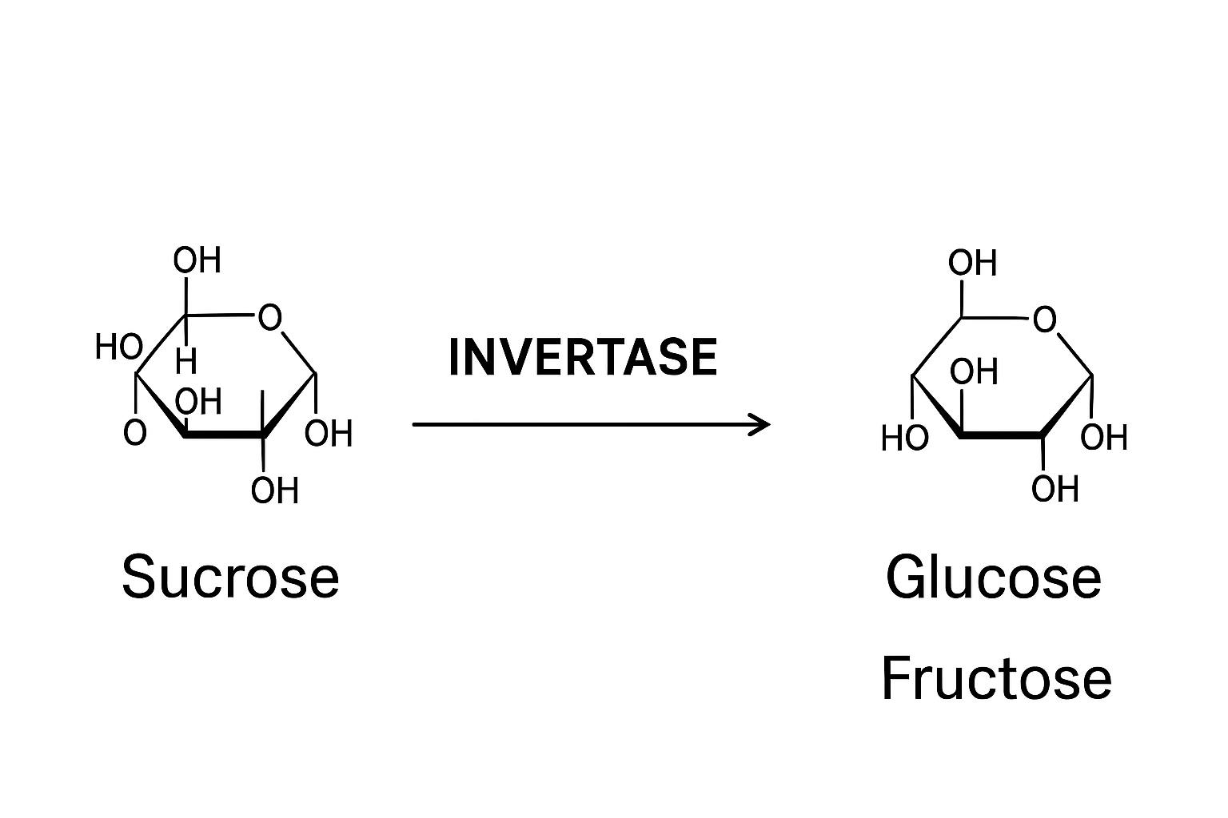
Invertase=An Enzyme That Breaks Down Sucrose
Sucrose Glucose + Fructose
Sucrose is a single disaccharide molecule made of glucose and fructose linked together by a glycosidic bond.When invertase acts,it breaks this glycosidic bond.
After the break down to glucose and fructose the mixture of this two forms the important thing that is INVERT SUGAR.

Slide 3
INVERT SUGAR
It is sweeter than sucrose(because fructose is very sweet).
More soluble in water and more soluble than sucrose.
Helps prevent crystallization of sugar.
Invertase Works Best At pH(4.5-5.5),Moderate Temperature(50-60*C),And High Sucrose Concentration-These Conditions Are Usually Maintained In The Food Industry For Maximum Production Of Invert Sugar.

Slide 4
SOURCES OF INVERTASE
Produced Naturally By Yeast
Some Insects Like Honeybees Produce Invertase In Their Saliva
Fungi Produces Invertase On large Scale

Slide 5
INDUSTRIAL ROLE
Industrial Role:
*Confectionery Industry: Invertase is widely used in making soft-centered chocolates and candies. The enzyme converts sucrose inside the chocolate coating into invert sugar, which keeps the center soft and creamy.
Food & Beverage Industry:It helps improve sweetness, prevent crystallization in syrups, and extend shelf life of baked goods.
Pharmaceuticals: Sometimes used in syrups to improve solubility and sweetness.

Slide 6
What would I do to make this industry more efficient?
According to my research in the industry bioreactors are used grow yeast that produces invertase, so here we can build a software which keeps an eye on the bio-reactor and notify that the process in the bio-reactor is complete.
Another thing is agitators and aerators which maintain mixing of glucose and sucrose and oxygen supply.Here we can build an automation thyrough sensors and a software which analysis the oxygen levels and mixing and do it more efficiently than a human,which finally leads to quality production.

Slide 7
REFERENCES
WIKIPEDIA
https://en.wikipedia.org/wiki/Invertase
SCIENCEDIRECT
https://www.sciencedirect.com/science/article/abs/pii/S1878818119319188

Slide 8
THANK YOU

